Slide 1
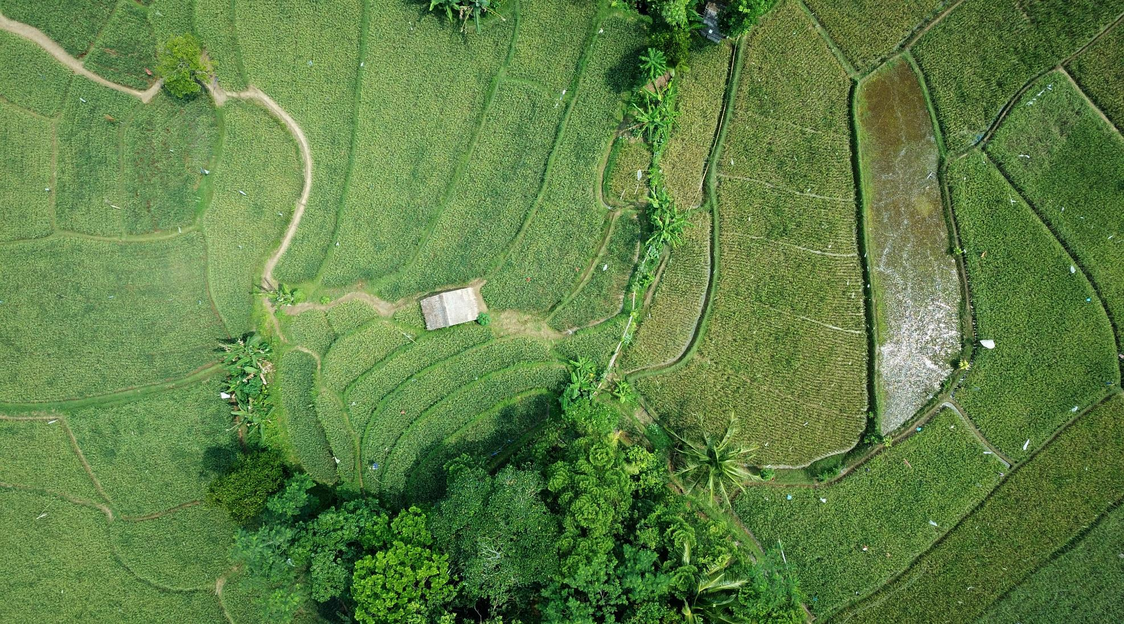
CannaMed
Panama, S.A.
Cannabis Reformed
CannaMed Panama, S.A. is a vertically integrated medical cannabis company, headquartered in Panama. The company began operations in 2019, serving the legal medical market with a focus on the cultivation and production of bulk cannabis flower and extracts.
Website Under Construction

Slide 2
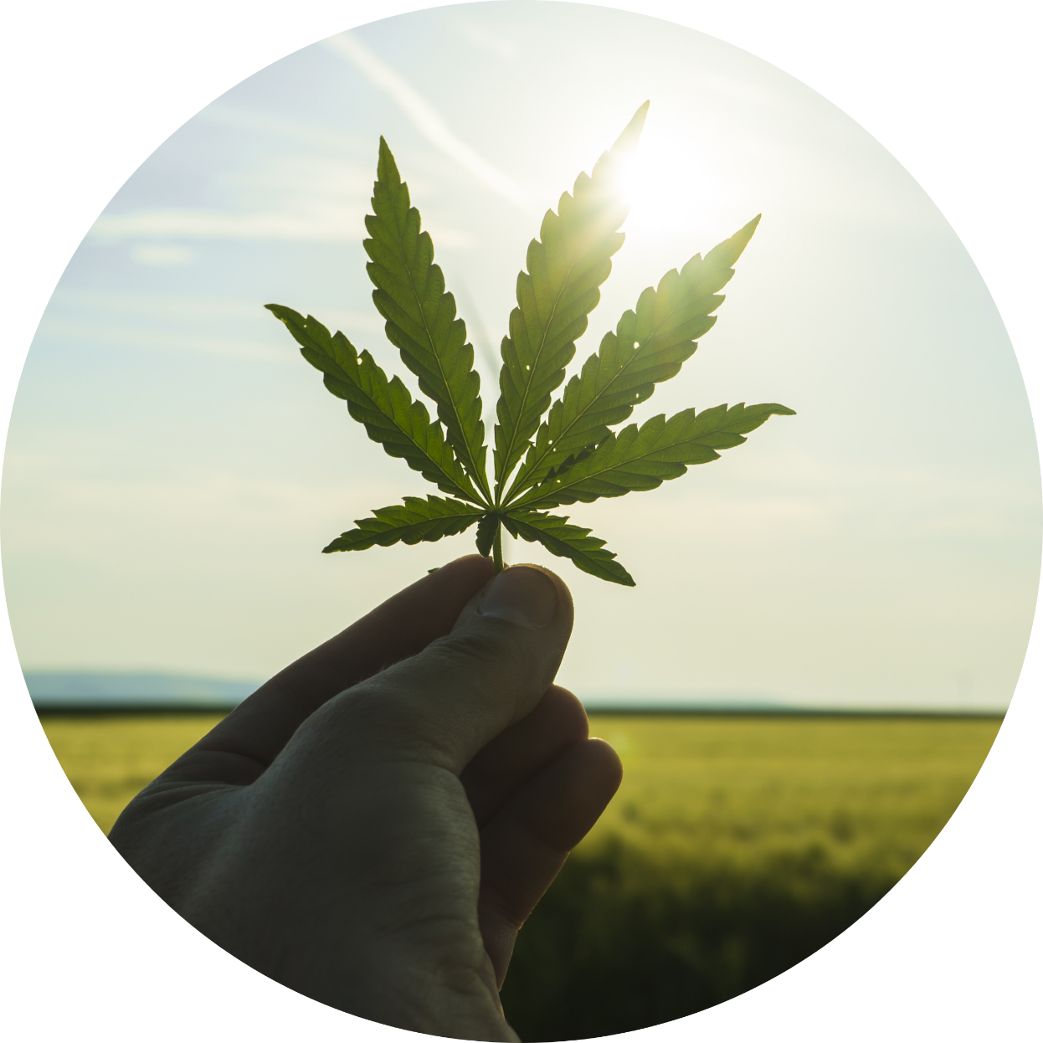
About Us
Mission
Utilizing ISO and GMP standards, we will develop a large scale, low-cost medical and recreational cannabis growing and processing facility to provide bulk THC flower and extracts to large pharmaceutical and cannabis suppliers in Canada, Europe and Latin America.
Location
We have a 100-acre cultivation area on a Panamanian island which presents a unique opportunity to produce certified medical cannabis at improved cost efficiency, reaching export markets through the free trade zone.
Value Proposition
Our expertise in ISO manufacturing and facility operations, in coalition with our ability to reduce operational costs, creates value that will be reflected in our expediated growth. Consistent growing conditions allows for year-round cultivation and 3 crops per year.

Slide 3





The Problem
Growing Costs
Cross Pollination
Short Seasons
Quality Control
High Op Costs
Growing cannabis indoors requires expensive infrastructure.
Outdoor growers face the risk of cross pollination from nearby farms.
Most outdoor cannabis farms are limited to 1 harvest per year.
Certified and consistent product is required to satisfy large customers.
Costs of labor, power and logistics can drive an operator out of the market.

Slide 4
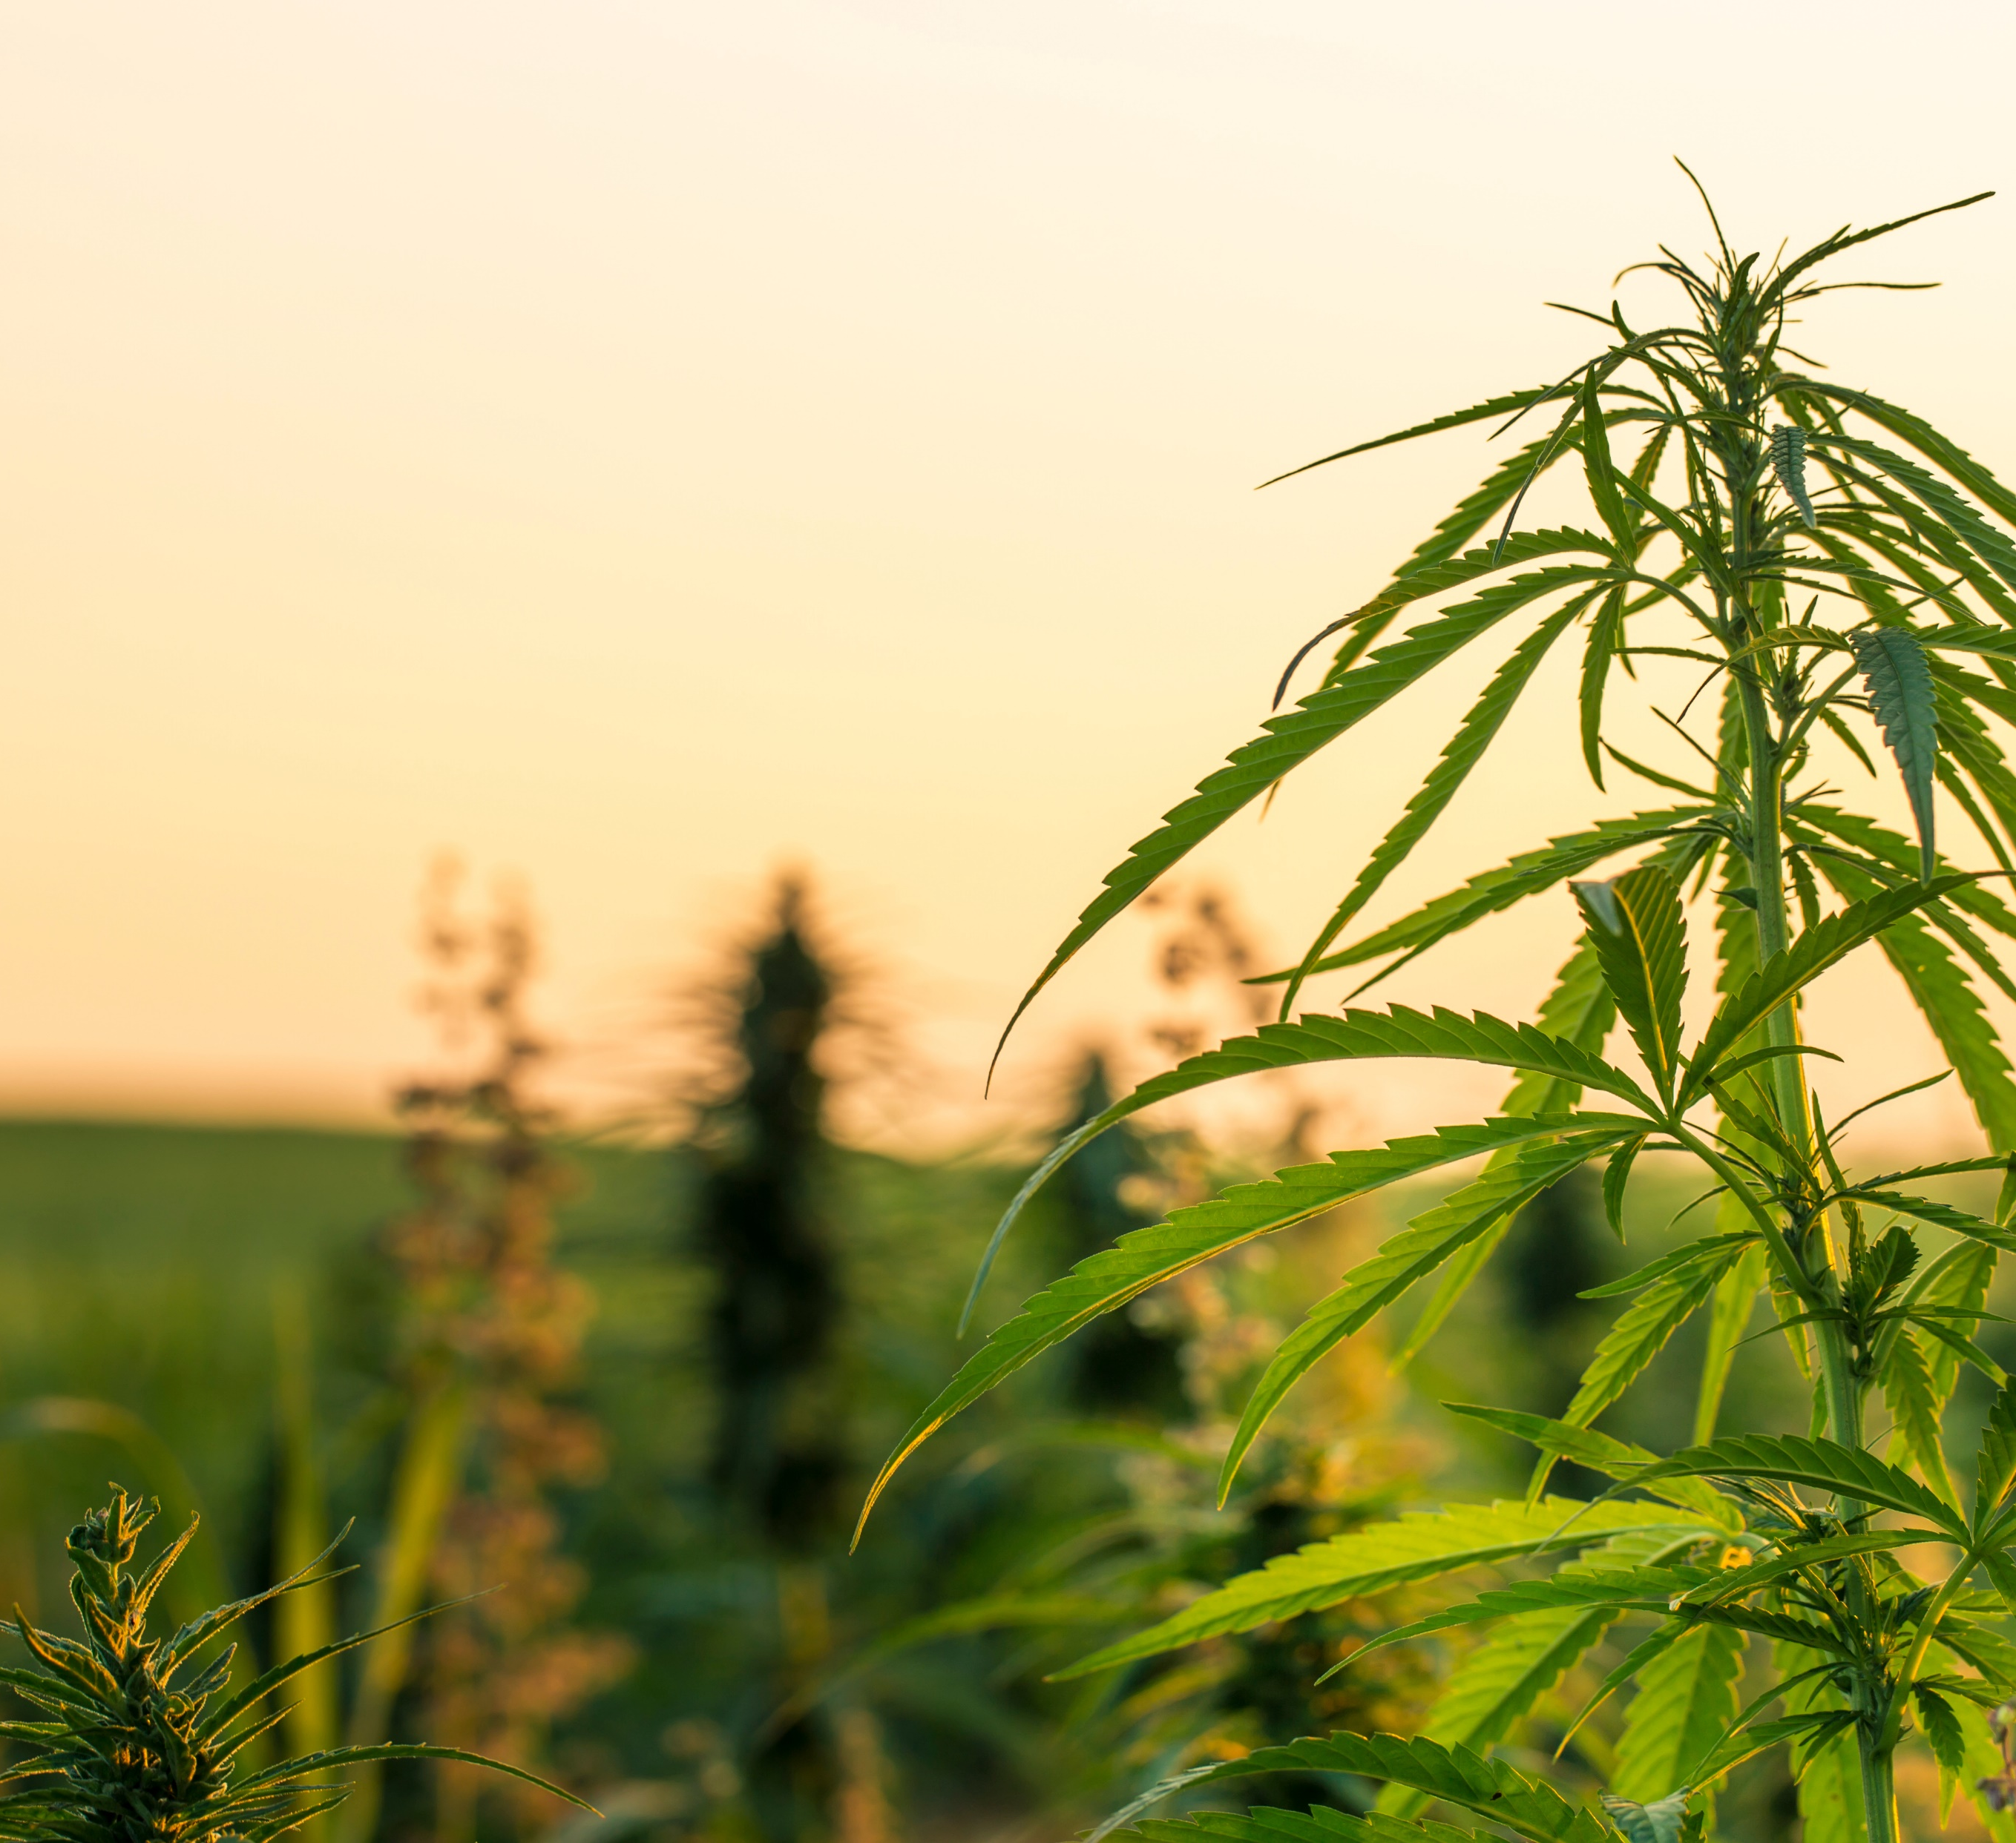



The Solution
Facility & Product Certification
Implementing ISO:9001 Quality Management System and GMP certification to ensure facility compliance and product quality.
Year-round Growing
Chosen site can produce 3 harvests per year, increasing staff utilization, harvest yield, and salable product inventory.
365
Cost Efficiency
Utilizing outdoor growing in a region with lower cost of labor and proximity to international markets for export, in addition to favorable tax structures, as the operation is classified as agriculture.

Slide 5

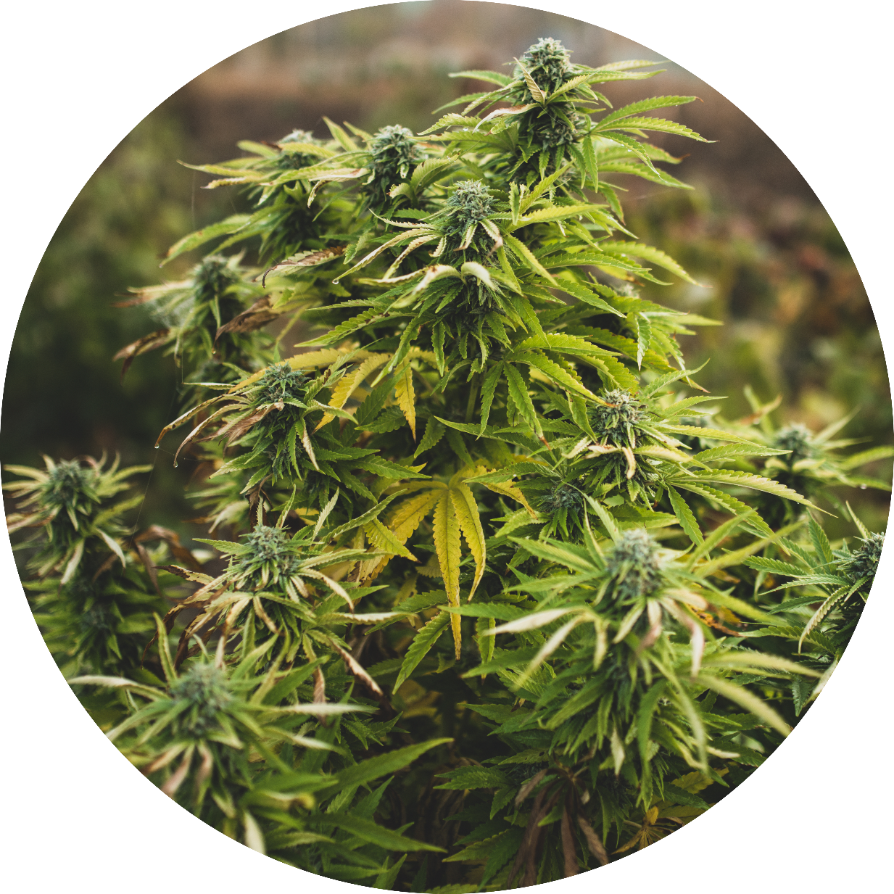


The Product
Certified Product
Certified, tested and traceable medical grade cannabis products.
Export Market
Utilizing the free trade zone to distribute product globally.
Outputs
Ability to sell smokable flower, winterized crude, distillate or isolate.

Slide 6






Location
Strain Selection
Consistent daily sunlight hours influences the strains we grow. Focusing on cultivars that are acclimated to growing in tropical environments.
Isolated Operation
Utilizing an island with no other farming operation on it, we eliminate risks from cross pollination while keeping capital costs down.
Fresh Water
This unique property has access to fresh water from both a network of natural springs and wells, enhancing cannabinoid production and overall product quality.
Security
The private island provides additional security in conjunction with legislated security protocols.
Transportation
The location has an airstrip and landing area for transport watercraft.

Slide 7
Processing & Distribution
On-site Drying, Trimming & Storage
Harvested product will go directly into the drying and trimming area, effectively eliminating transportation costs.
1
Processing Facility
The processing facility will be connected to the storage area and will house a 5,000lb per day extraction and winterization operation.
2
Distribution
3
Final products will leave the island for distribution, ensuring costs aren’t incurred on transport of input materials.

Slide 8





Business Model
Utilizing a Panamanian island to overcome traditional medical cannabis hurdles.
Superior Product
Cost Reduction
Certified, tested and traceable medical cannabis flower and extracts.
Low-cost labor, year-around harvest, and onsite processing increases output and utilization.
Vertical Integration
Export Market
Integration of genetics, farming, processing and testing facilities to retain margins.
Utilizing the free trade zone to distribute product globally.
8

Slide 9


Market Opportunity
$38B
$66B
North America market for cannabis was $17.7B in 2019 and expected growth of 18% CAGR over the next 8 year (Grandview research).
Expected market size of $38B in 2024
Cannabis market excluding North America is expected to grow to $66B by 2024
Increased legalization globally and strong growth in the medical portion of the business.
World Health Organization (WHO) removed cannabis and cannabis resin from Schedule IV of the 1961 Single Convention on Narcotic Drugs in 2020.

Slide 10
Competitive Analysis
Factors | Panama | USA | Canada | Africa
Stable Government
Cannabis Regulations
Favorable Corporate Taxes
Outdoor Growing
Three Crops Per Year
Low Environmental Risk
Domestic Recreational Use
Low Labor Costs
Free Trade Zone
Export Possible
Notes:
Year round growing season provides continuous production
Low input costs enable better returns
Geographic location provides superior access to North and South American markets
Free trade zone enables access to global markets
100 acres of outdoor growing operation
Onsite extraction and processing
Rule of law, regulations, government stability, storm region, tax

Slide 11
Growth Strategy
Scaling for the future.
Phase 1
Complete
Phase 2
Q1, 2021
Phase 3
Q2-Q4, 2021
Phase 4
Q1, 2022
Identify region
Work with legislators for outdoor cultivation license
Secure land for farming, processing and testing
Build out operations and technical team
Identify optimal plant genetics for the region
Obtain growing and processing license
Capital raise
Procure cultivation, processing and testing equipment
Expand the team to include onsite operations
Begin drying and processing facility construction
Initiate grow operation with 20-30 acres
Complete drying and processing facility
Secure offtake agreements
Increase farming operation to 50 acres
Apply for ISO 9001:2015 certification for company
Apply for GMP certification (drying & processing)
Development of genetics program
Begin extraction facility construction

Slide 12
Timeline
Our 18-month action plan.
Legislation Passes
Begin Drying Facility Construction
Plant Crop 1
Harvest Crop 1
Harvest Crop 2
ISO &GMP Application
DEC
JAN
FEB
MAR
APR
MAY
JUN
JUL
AUG
SEP
OCT
NOV
DEC
JAN
FEB
MAR
APR
2020
2021
2022
Land Prep
Site Development
Obtain Growing License
Plant Crop 2
Plant Crop 3
Complete Drying Facility
Begin Lab Construction
Equipment Selection
Build-out Team
Begin Capital Raise

Slide 13






Industry Metrics
Base Case Metrics.
Production Metrics:
Production Cost / G Dry Flower: $0.04 - $0.06
Production Cost / G Crude Oil: $0.26 - $0.30
Production per Crop Cycle:
Cultivation Space: 100 Acres
Crop Cycles / Year: 3 Cycles
Flower Production / Acre / Cycle: 400 – 450 kg
Crude Oil Production / Acre / Cycle: 70 – 80 L

Slide 14
Forecast
Forecasting for Success.
 | 2021 | 2022 | 2023
Harvested Acres / Yr. | 75 | 200 | 300
Revenue ($000) | $12,218 | $36,107 | $59,449
COGS ($000) | $1,637 | $4,343 | $6,480
SG&A ($000) | $5,941 | $14,662 | $23,363
EBITDA ($000) | $4,460 | $17,103 | $29,606

Slide 15
Financials

Slide 16




Use of Proceeds
$1.4M – Initial Crop
$4M – Working Capital
Seeds
Planting
Irrigation
Harvest
Labor
Overhead
Commissioning
$0.6M – Cultivation
Tractors
Cultivators
Nursery
Irrigation
$10.1M – Processing
Dryer
Milling
Extraction
Lab Facility
Pre-Money Valuation: $60M

Slide 17
Project analysis slide 8
Risk Analysis
POSITIVE
NEGATIVE
STRENGTH
WEAKNESS
First mover advantage; 1 of 3 permits in Panama
Experienced team of Directors
Low-cost producer with ability to export
Lack of established distribution channels
Management team not yet in place
Farming and extraction infrastructure not complete
INTERNAL
OPPORTUNITY
THREAT
Ability to increase cultivation to 250 acres
Expansion into new branded products
Well positioned when new, large markets (US and EU) legalize
Tropical climate increases risk of crop loss
Uncertain regulatory environment worldwide
Possible increased competition from other low-cost countries
EXTERNAL

Slide 18
Team
Directors
Jed Wood
George Novey
Ruben Arosemena
Agricultural Advisor
COO
CFO
Operating Partner
Jeff Laberge
David Harrop
Dr. William Richardson
Kingsman SM
Management

Slide 19
Management Bios
Jed M. Wood
George Novey
Ruben Arosemena
Founder, Chairman & CEO
(Canada)
Serial entrepreneur for over 40 years
Founded and operated multiple oil & gas and healthcare companies
Served on BOD of 8 publicly traded companies
Early-stage investor and operator in cannabis industry
Founder, Director
(Panama)
Business entrepreneur in transport production, cultivation, transport of derivates from commercial fishing and aquaculture
Founder and First Director of Panama’s Authority for Aquatic Resources Entity
Presently BOD for Promarina Fish Meal Factory
Founder, Director
(Panama)
Career Panamanian politician and attorney
Former 2nd Vice President of Panama
Former President of the Panamanian National Assembly
Former Panamanian Ambassador to South Korea

Slide 20
Management Bios
Jeff LaBerge
Dr. Bill Richardson
David Harrop
Chief Operating Officer
(United States)
Seasoned finance and business development professional
Over 15 years of experience in agriculture, renewable energy and healthcare
Founded and operated one of the first Industrial Hemp and CBD companies in California
Agricultural Advisor
(United States)
Served as Dean of the LSU College of Agriculture since 2013
Head of LSU Medical Marijuana Program
Chief Financial Officer
(Canada)
Highly experienced financial executive
Held CFO position for two publicly traded entertainment and gaming companies
Served as CFO for family offices as well as privately held companies

Slide 21
Summary
We provide certified medicinal cannabis to global markets.
Location
Certified Facility & Products
Cost Reductions
Yield
First to Panama: We will be the first industrial scale cannabis growing and processing facility in the country with favorable regulations for quick start-up.
Low-cost Production: Utilizing vertical integration and lower input cost, we can deliver higher return on investment.
Certified and Tested: Proactive innovation by certifying the facilities and products to enable smooth exportation to global markets.
Yield: Turning 3 crops per year on 100-acre plot of land provides unmatched scale for THC production.

Slide 22

Thank You
CannaMed Panama, S.A

